Slide 1


Slide 2




A'tugwewinu : Martina Clement Gislugwatg : Marilyn Jacques Gisimawilugwatmi'tij :
Lillian Germain Blanche Metallic Jessica Metallic Vicky Metallic Lola Vicaire
'Nnu'gina'muejig : Mary Ann Metallic aqq Janice Vicaire Niganpugutg Siawiminuignewa'tu'g 'Gtli'sutiminu : Marsha Vicaire Napwi'gigng Gisa'laji : Milaine Mercier-Pitre
Copyright © 2019 Listuguj Education, Training & Employment
All rights reserved. Images cannot be duplicated or reproduced without written consent of the copyright holders of this resource.
Title : Ta'n Teloltieg'p Maljewe'juianeg ISBN : 978-1-989538-02-9
Date : 201910
“Siawiminuignewa’tu’g ‘Gtli’sutiminu” Listuguj Education, Training & Employment 1 Riverside West,
Listuguj, QC G0C 2R0 www.listuguj.ca

Slide 3


Slide 4
1

Slide 5
Jini etlagnutmuit ta’n telmila’sip maljewe’juiteg. Ta’n goqwei migwite’tg na gaqi’sg
almila’sip sitmug. Mawigsatg’p eltoq sisgueie’l gegsl.
2

Slide 6

3

Slide 7
E’w’g’p ta’n goqwei we’jitoq aljeteg sitmug
ugjit gegsoqq. Na pitgmalatl wowl tupgwan aqq ta’s’g samuqwan, toqo mesiapoqte’g glapis gisitoq sisgu.
4

Slide 8


Slide 9
Pijiguta’toq ula sisgu gegso’qigtug.
Toqo gwilgl guntal, wasuegl, ‘msigu’l aqq nipi’g ugjit gegsei amalugwaqan.
6

Slide 10
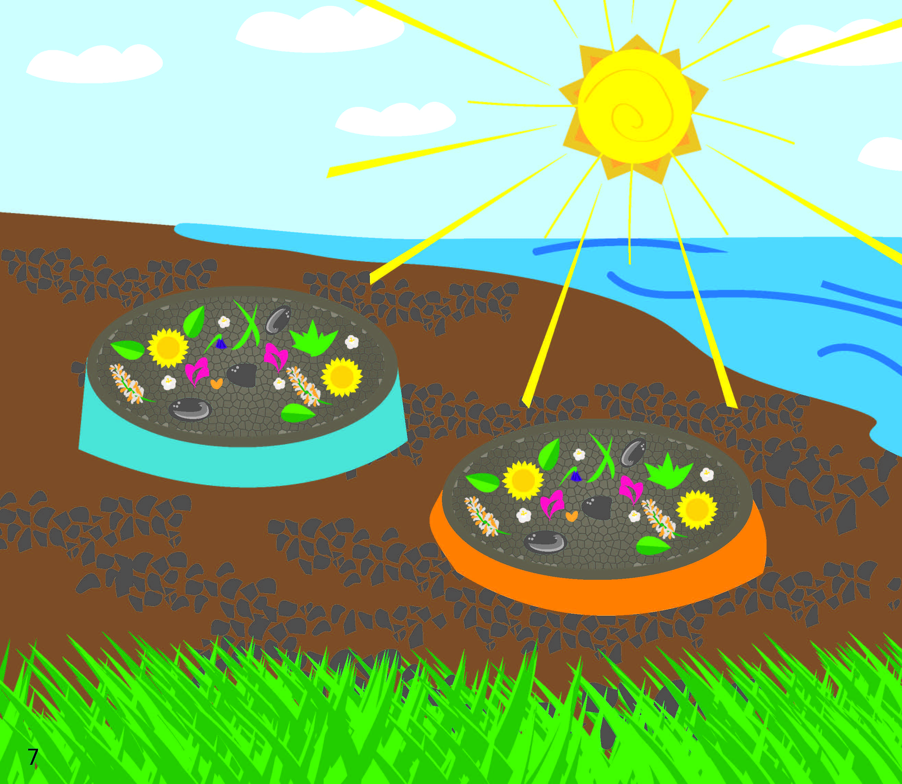

Slide 11
Iga’toqol gegsl ta’n na’gu’set etlwelasej glapis gispateg.
8

Slide 12
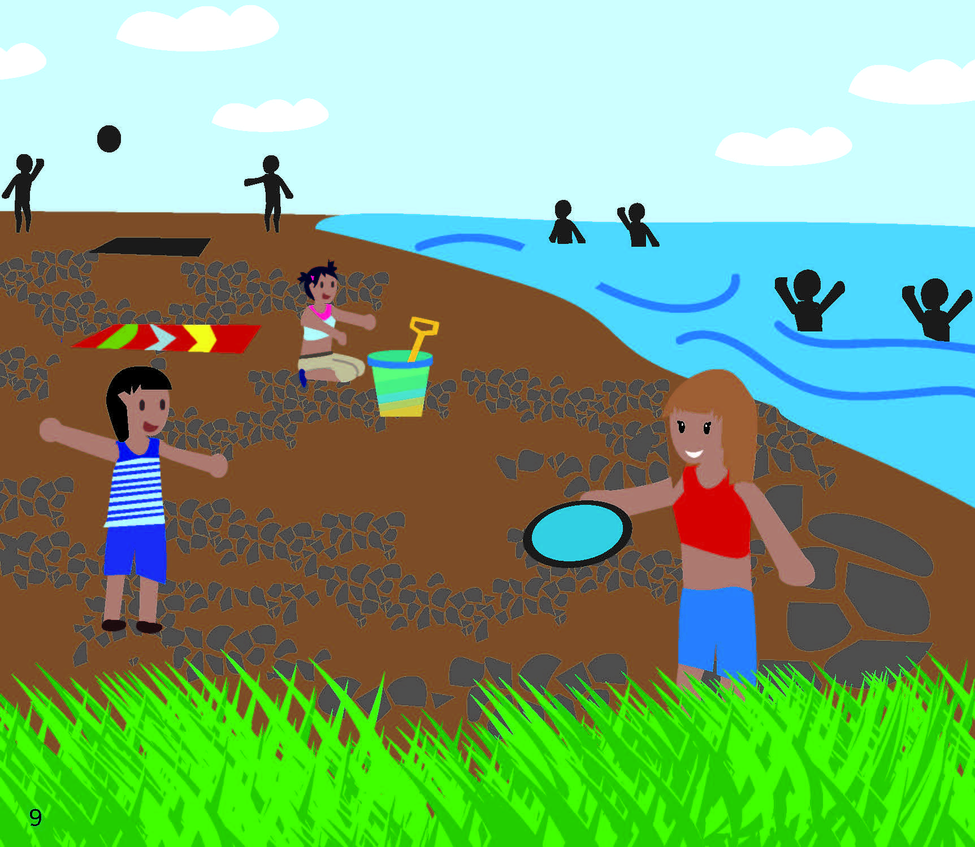

Slide 13
Ta’n tujiw gaqitoq gegsl na tegismit.
Na tujiw, mawpugwelg’pnig mimajuinu’g tegismultijig.
10

Slide 14
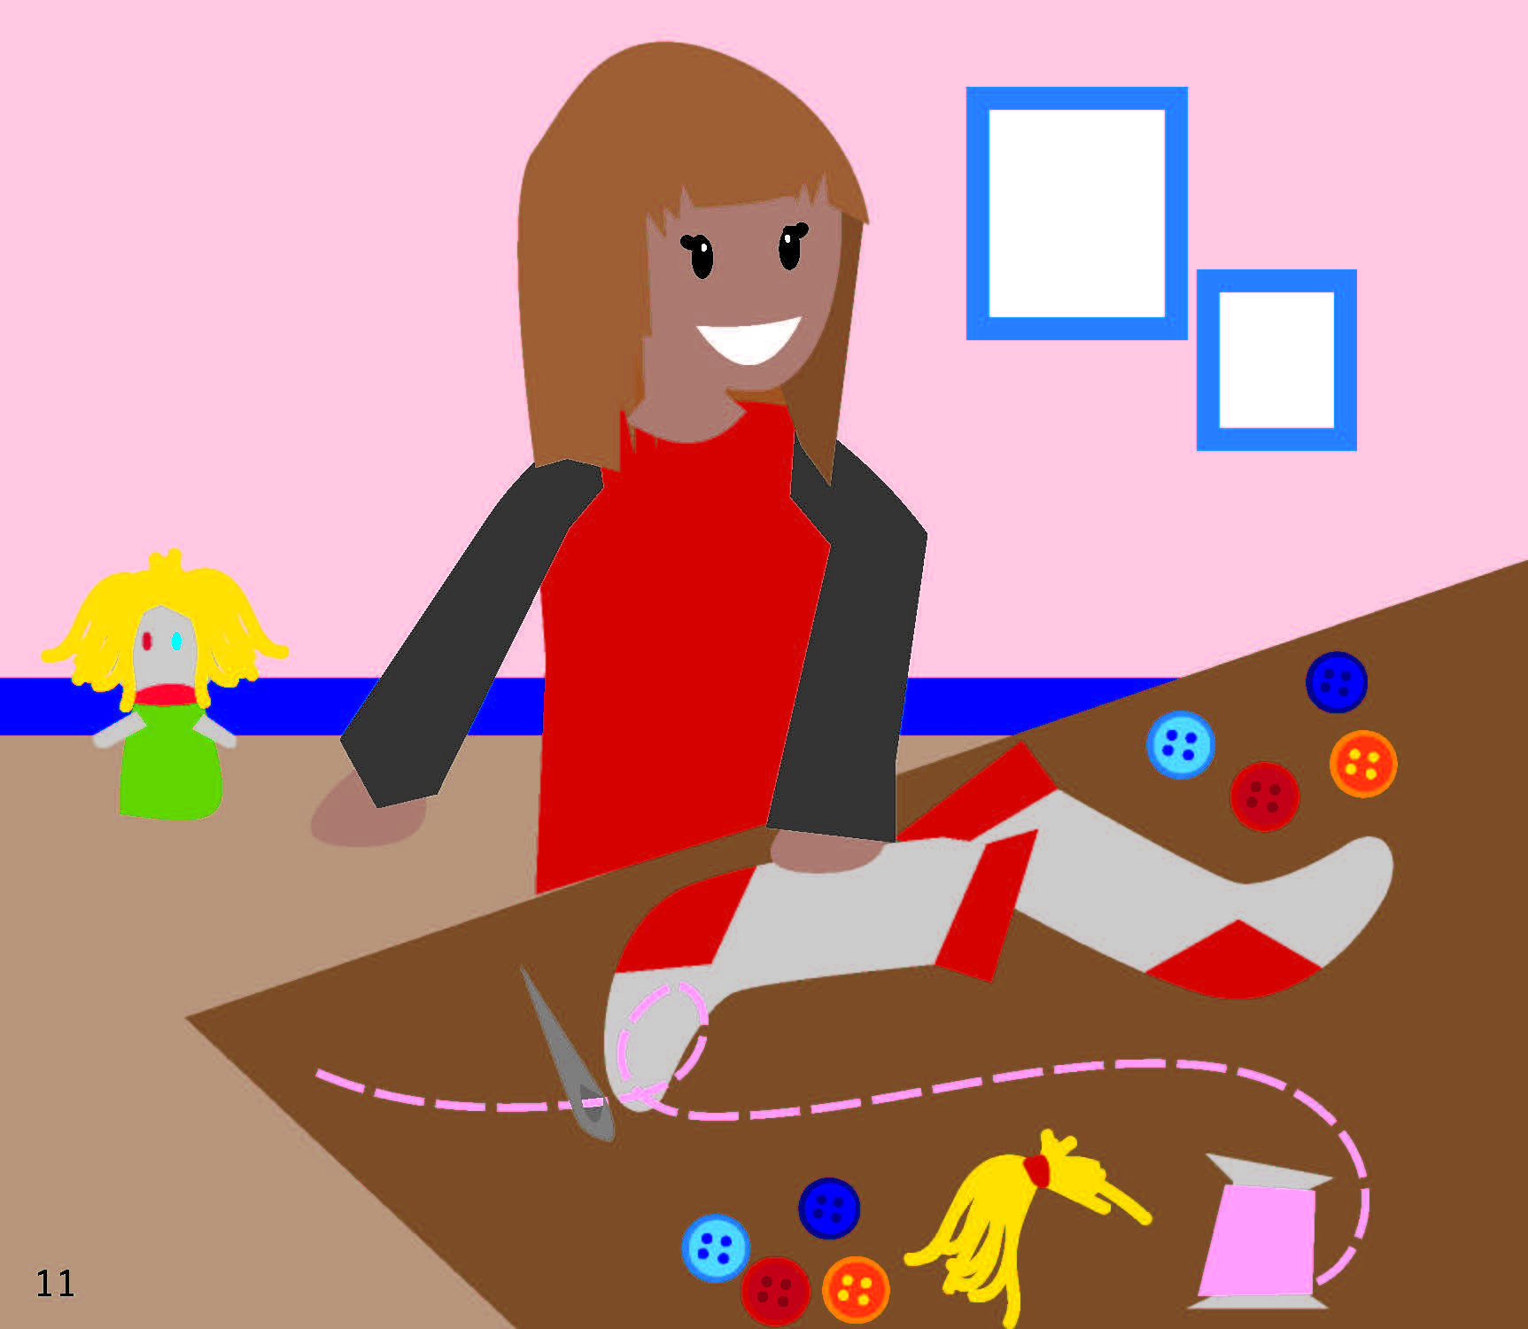

Slide 15
Jini migwite’tg ta’n i’tli’sewep.
Gesatg’p eltoq apsute’gane’l aligal.
12

Slide 16


Slide 17
Welmigwite’tg na te’sigisg’g gujmug almilita’pnig.
Mawiawisiw lamuguomg eig’p wen.
Gisgug, maljewe’jg etlmilita’jig lamuguomg gisna ela’lujig iga’taqanigtug telueget ugjit milita’new.
14

Slide 18


Slide 20








“Siawiminuignewa’tu’g ‘Gtli’sutiminu” Listuguj Education, Training & Employment 1 Riverside West,
Listuguj, Qc G0C 2R0 www.listuguj.ca

